Slide 1
Software Architecture Challenges for ML Systems
Grace A. Lewis, Ipek Ozkaya, Xiwei Xu

Slide 2
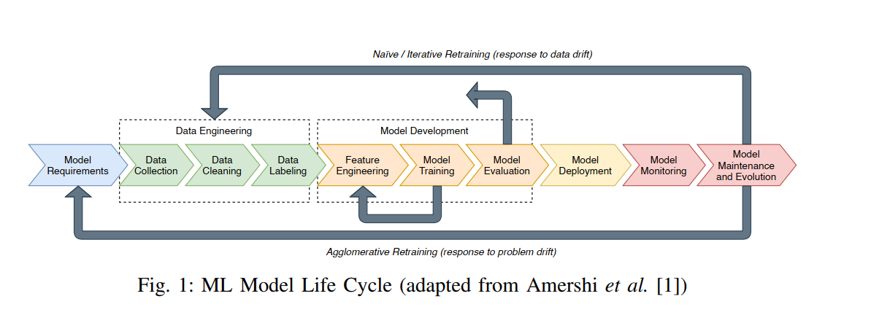
Introduction

Slide 3
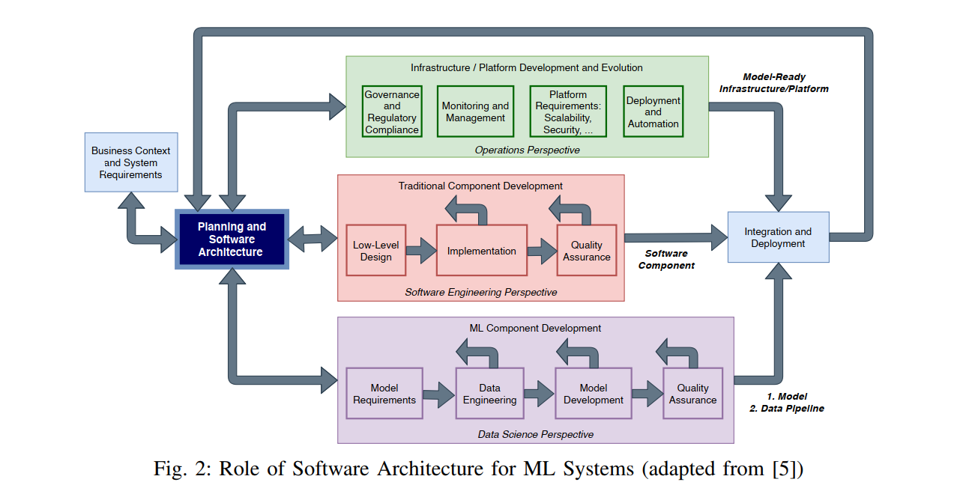

Slide 4
Challenge 1: Adapting Software Architecture Practices for ML Systems
Data-Dependent Behaviour
Continuous Learning and Adaptation
Handling Uncertainty and Volatility

Slide 5
Challenge 2: Failures Related to Architecturally Significant Requirements
The unique and critical quality attributes (QAs) that machine learning (ML) systems require but Traditional software architecture practices do not fully address these specialized needs, necessitating the development of new or adapted architectural patterns and tactics.

Slide 6
Understand High-Priority Quality Attributes of ML-Enabled Systems
Quality Attributes (QAs)
Explainability
Data Centricity
Verifiability
Monitorability
Observability
Fault Tolerance

Slide 7
Challenge 3 : Lack of Monitorability
While monitorability is not a QA that is specific to ML systems, it is key to the proper operation and sustainment of ML systems. Unlike traditional software systems, ML systems require continuous monitoring to ensure they are functioning correctly and delivering accurate results over time.

Slide 8
Decouple Different Aspects of Monitorability
Understand what different monitoring techniques will be needed for data quality vs. model quality vs. software quality vs. service quality
Explore relationship between monitorability to self-adaptation in ML systems
of ML — ML models self-adapt to system changes (one of the goals of MLOps)
for ML — ML system adapts to changes that affect quality of service (QoS)
by ML — system uses ML techniques to adapt (some of this research is already happening in the self-adaptive systems community)

Slide 9
Challenge 4: Lack of Recognizing Two Related Architectures in Play
This challenge arises from the complex and intertwined relationship between the ML models and the systems that support their development, deployment, and maintenance.
An ML system has two software architectures that need to be developed and sustained in sync.
Architecture of the pipeline that produces the ML model (or other AI components if applicable)
Architecture of the system which uses and interacts with the AI/ML component

Slide 10
Co-Architecting and Co-Versioning
Co-Architecting: Both pipeline and system architectures need to be developed and sustained in sync such that design decisions are driven by both system and model requirements
Co-Versioning: Versioning in ML systems needs to provide traceability from training dataset to parameters to model to evaluation dataset to results to deployed model
Key practice for maintenance and evolution

Slide 11
Assumptions
The paper assumes consistent availability of high-quality data, which may not always be the case.
The paper assumes that organizations are prepared to adopt CI/CD practices tailored for ML systems.
The paper assumes sufficient resources for monitoring and maintaining ML systems.

Slide 12
Discussion
Considering the rapid pace of advancements in ML and AI technologies, how might these changes impact the longevity and relevance of the proposed architectural practices?
How might increasing regulatory requirements around data security and ML operations impact the architectural design of ML systems?
Any specific challenges for legacy systems while Implementing Modern ML Architectures ?

